Slide 1
Weekly meeting
11 14 2024
Ty Bottorff

Slide 2
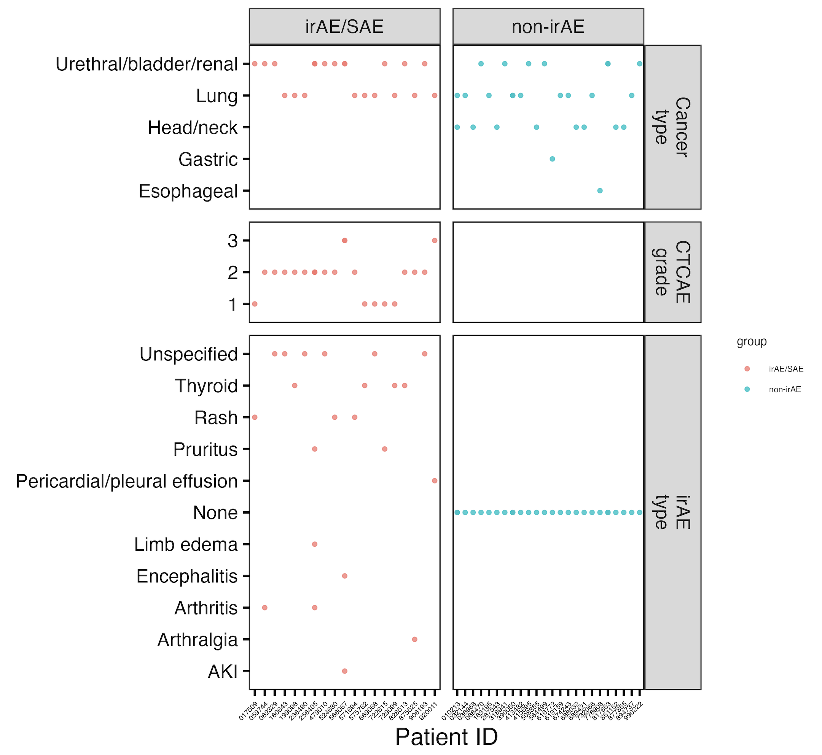
Outline
NCI irAE follow ups
AbATE figure organizing for manuscript

Slide 3
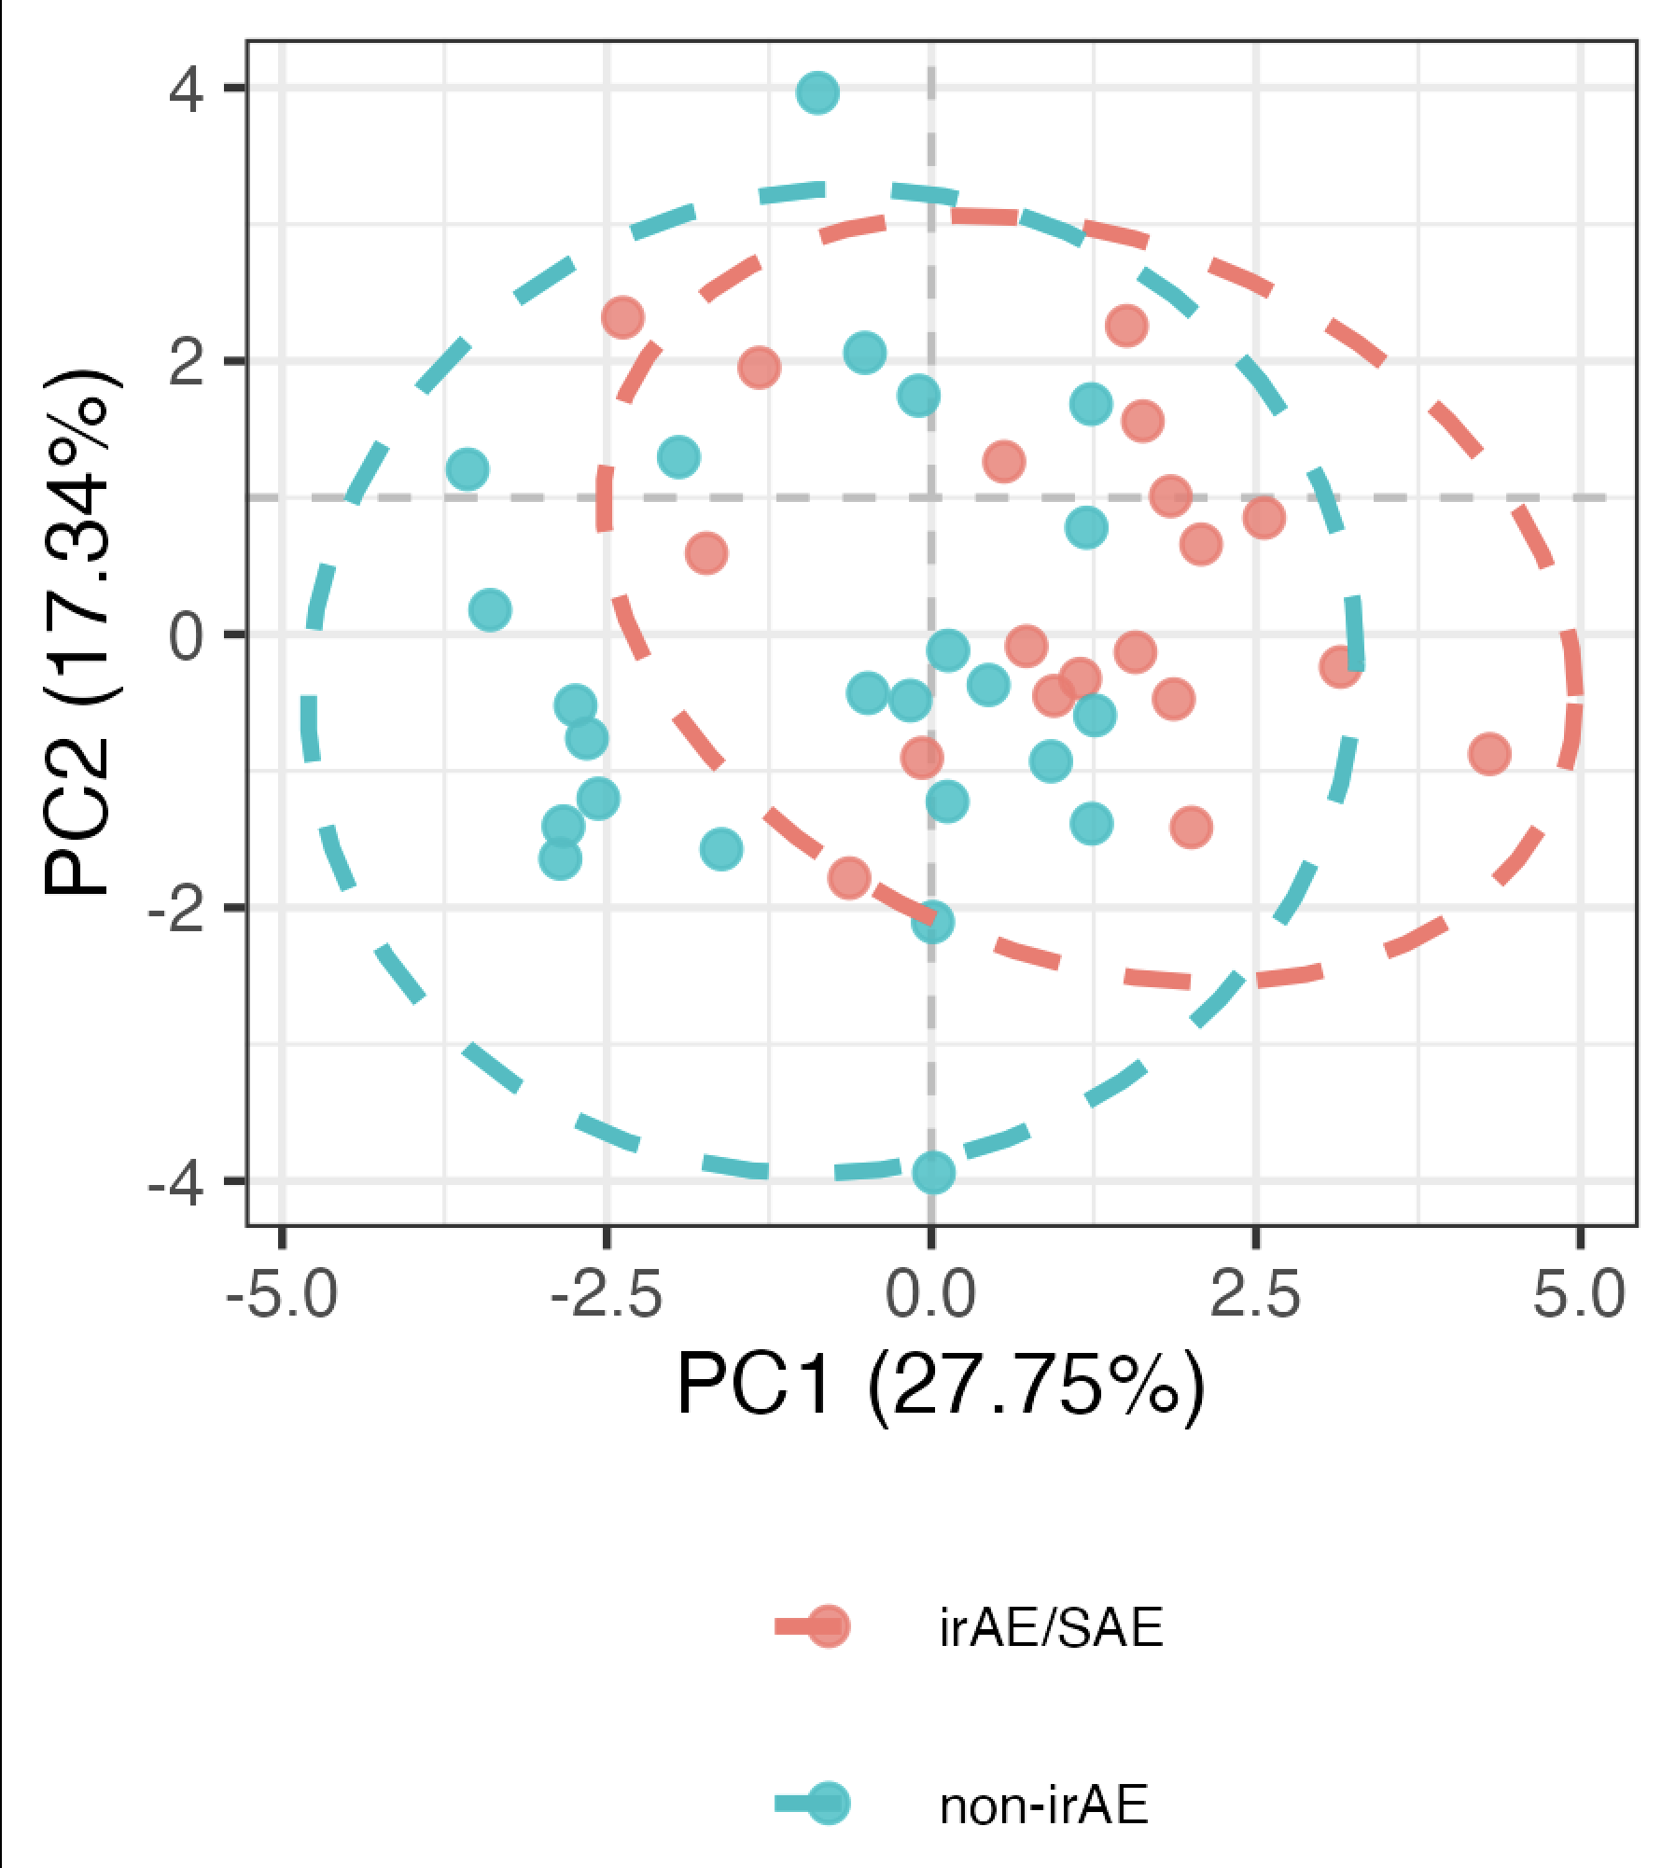
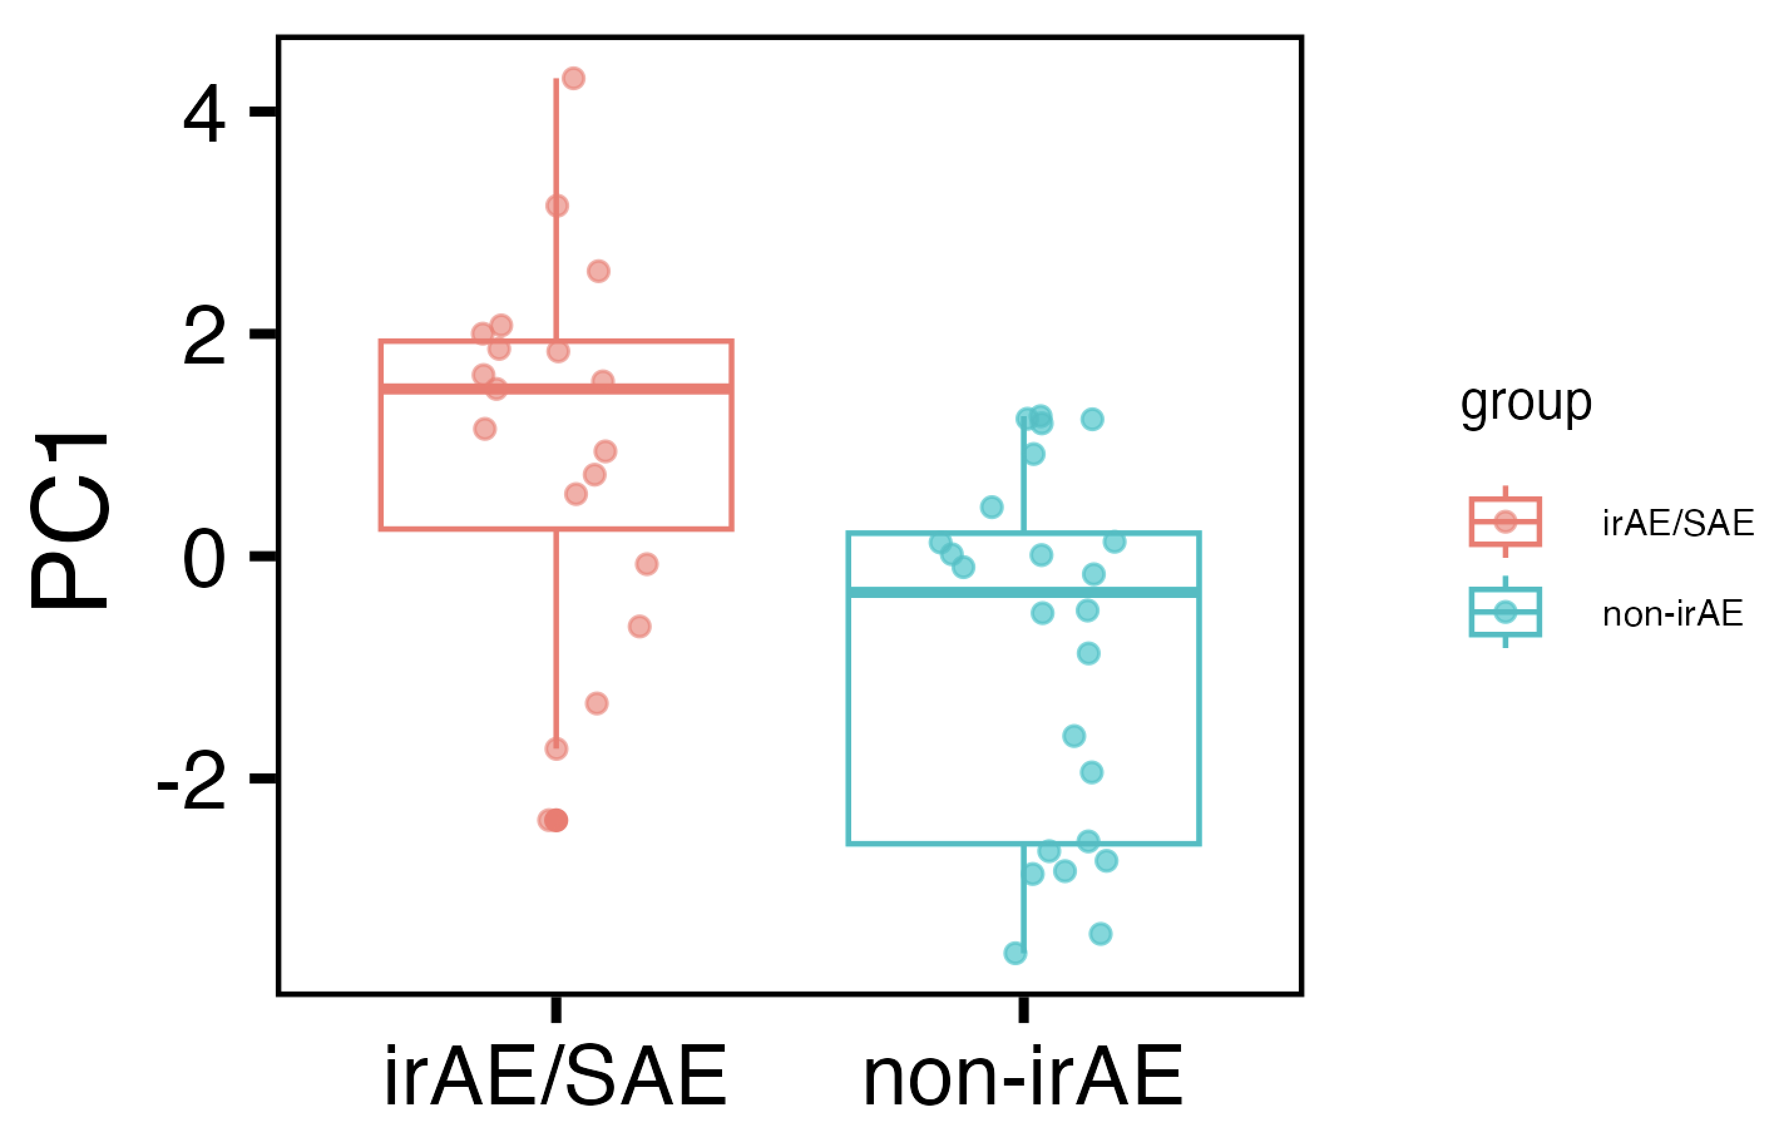
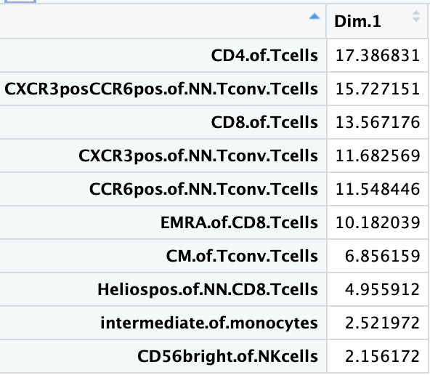
Baseline immunotypes do differ between irAE groups in PC1 of PCA using top features
PC1: p = 0.001
Notes:
Batch corrected, logit transformed, Z-scored freqs
Top 13 features here chosen from stats of batch-corrected logit transformed z-scored data unadjusted pval < 0.1
Directionality in PC space is arbitrary, so refer to mean module slide (next slide) for directionality

Slide 4
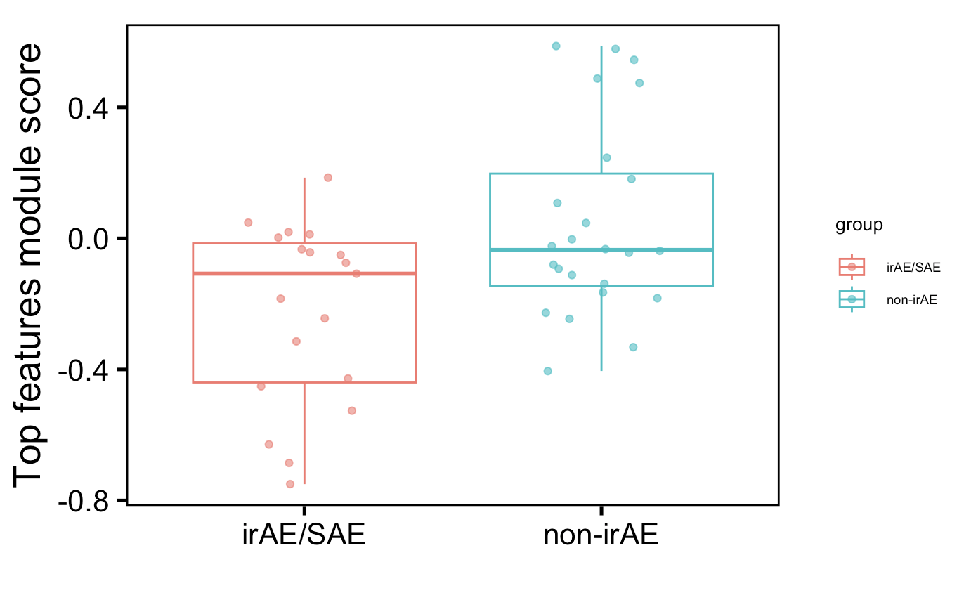
Also observe difference in mean module of top features (using more than previously)
p = 0.03
Notes:
Batch corrected, logit transformed, Z-scored freqs
Top 13 features here chosen from stats of batch-corrected logit transformed z-scored data unadjusted pval < 0.1

Slide 5
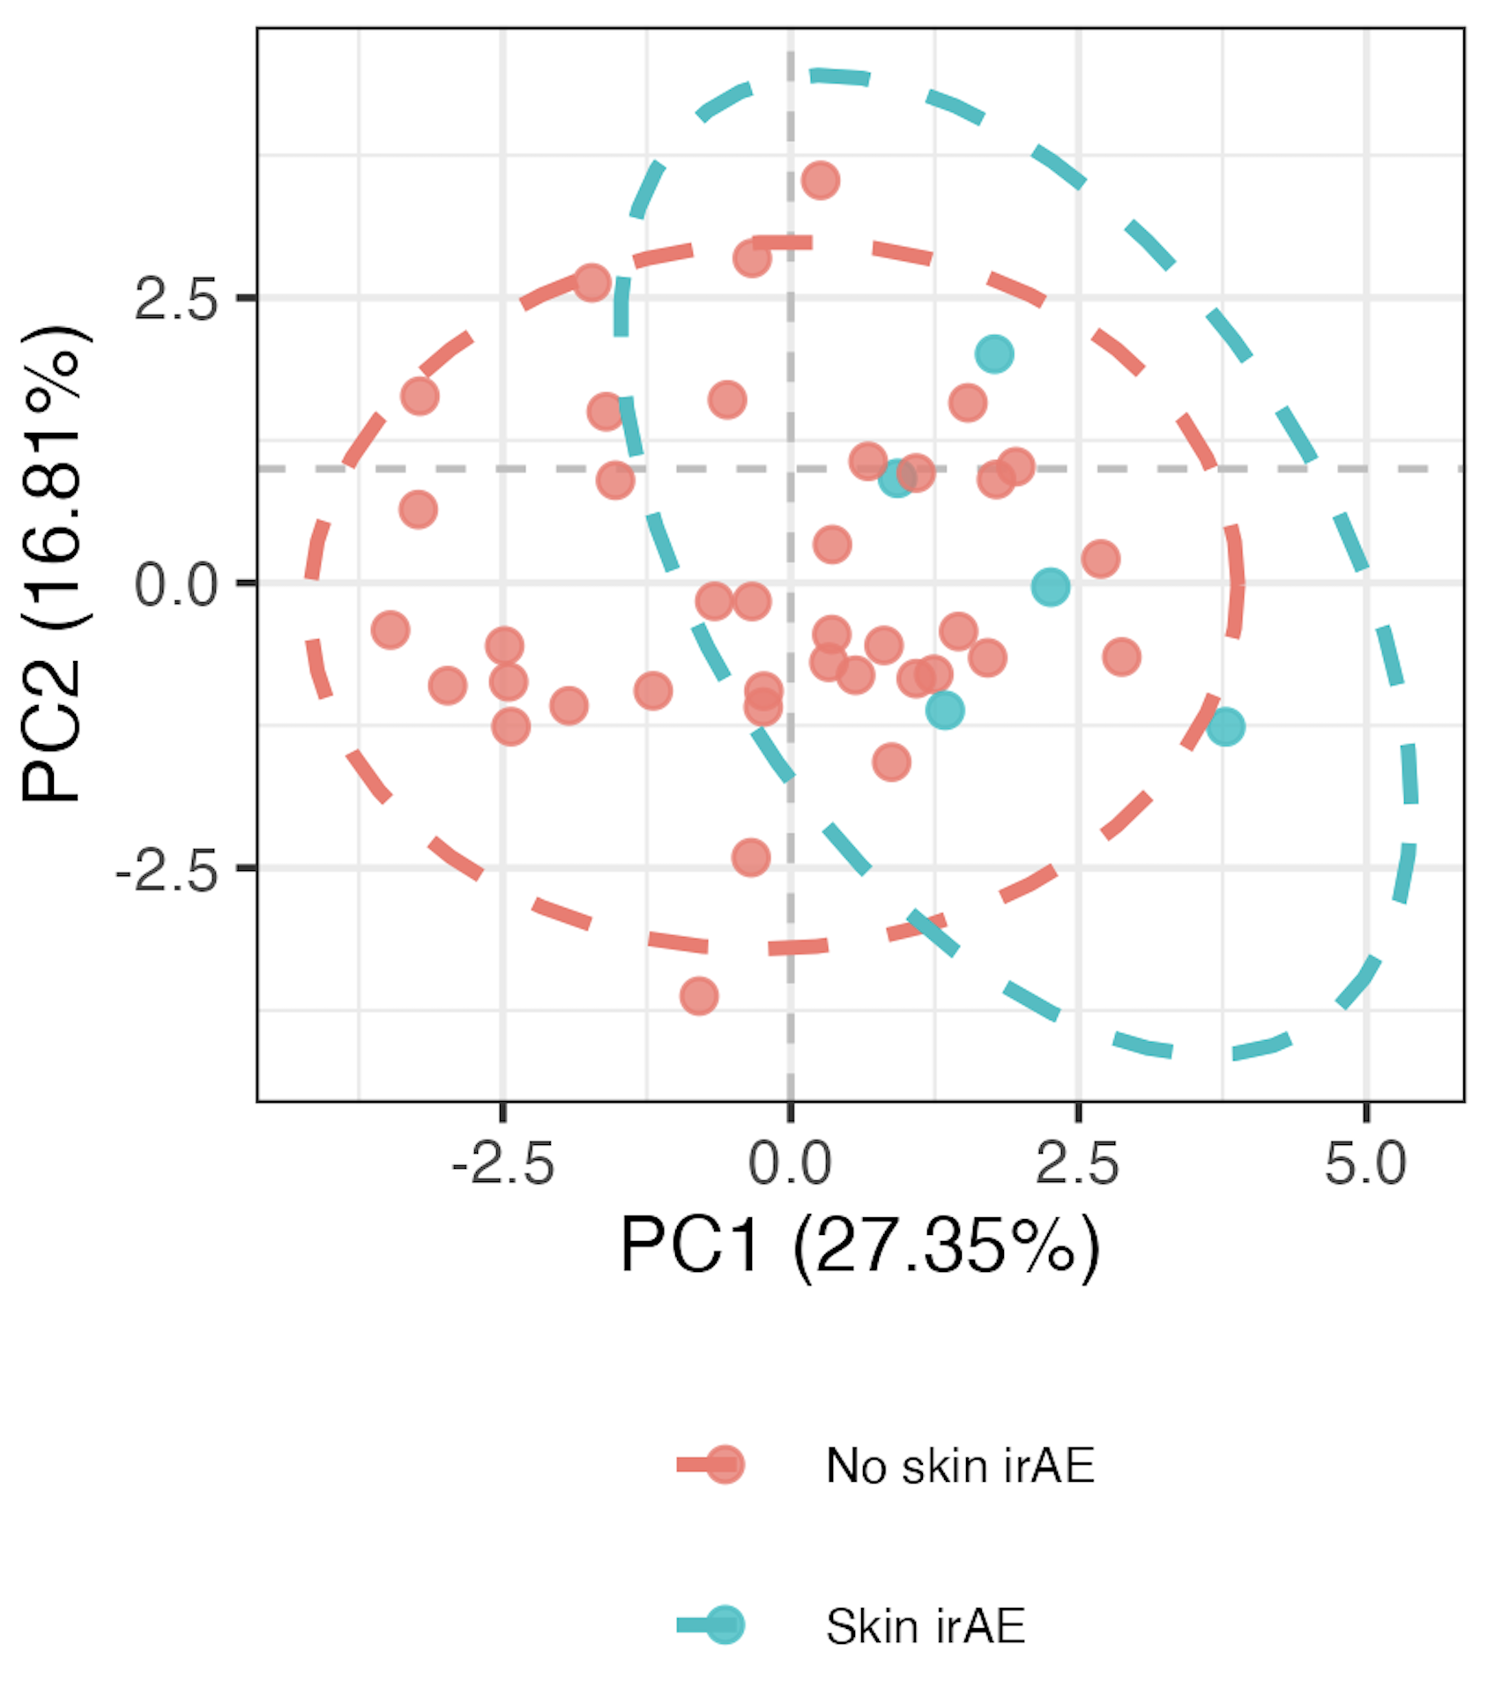
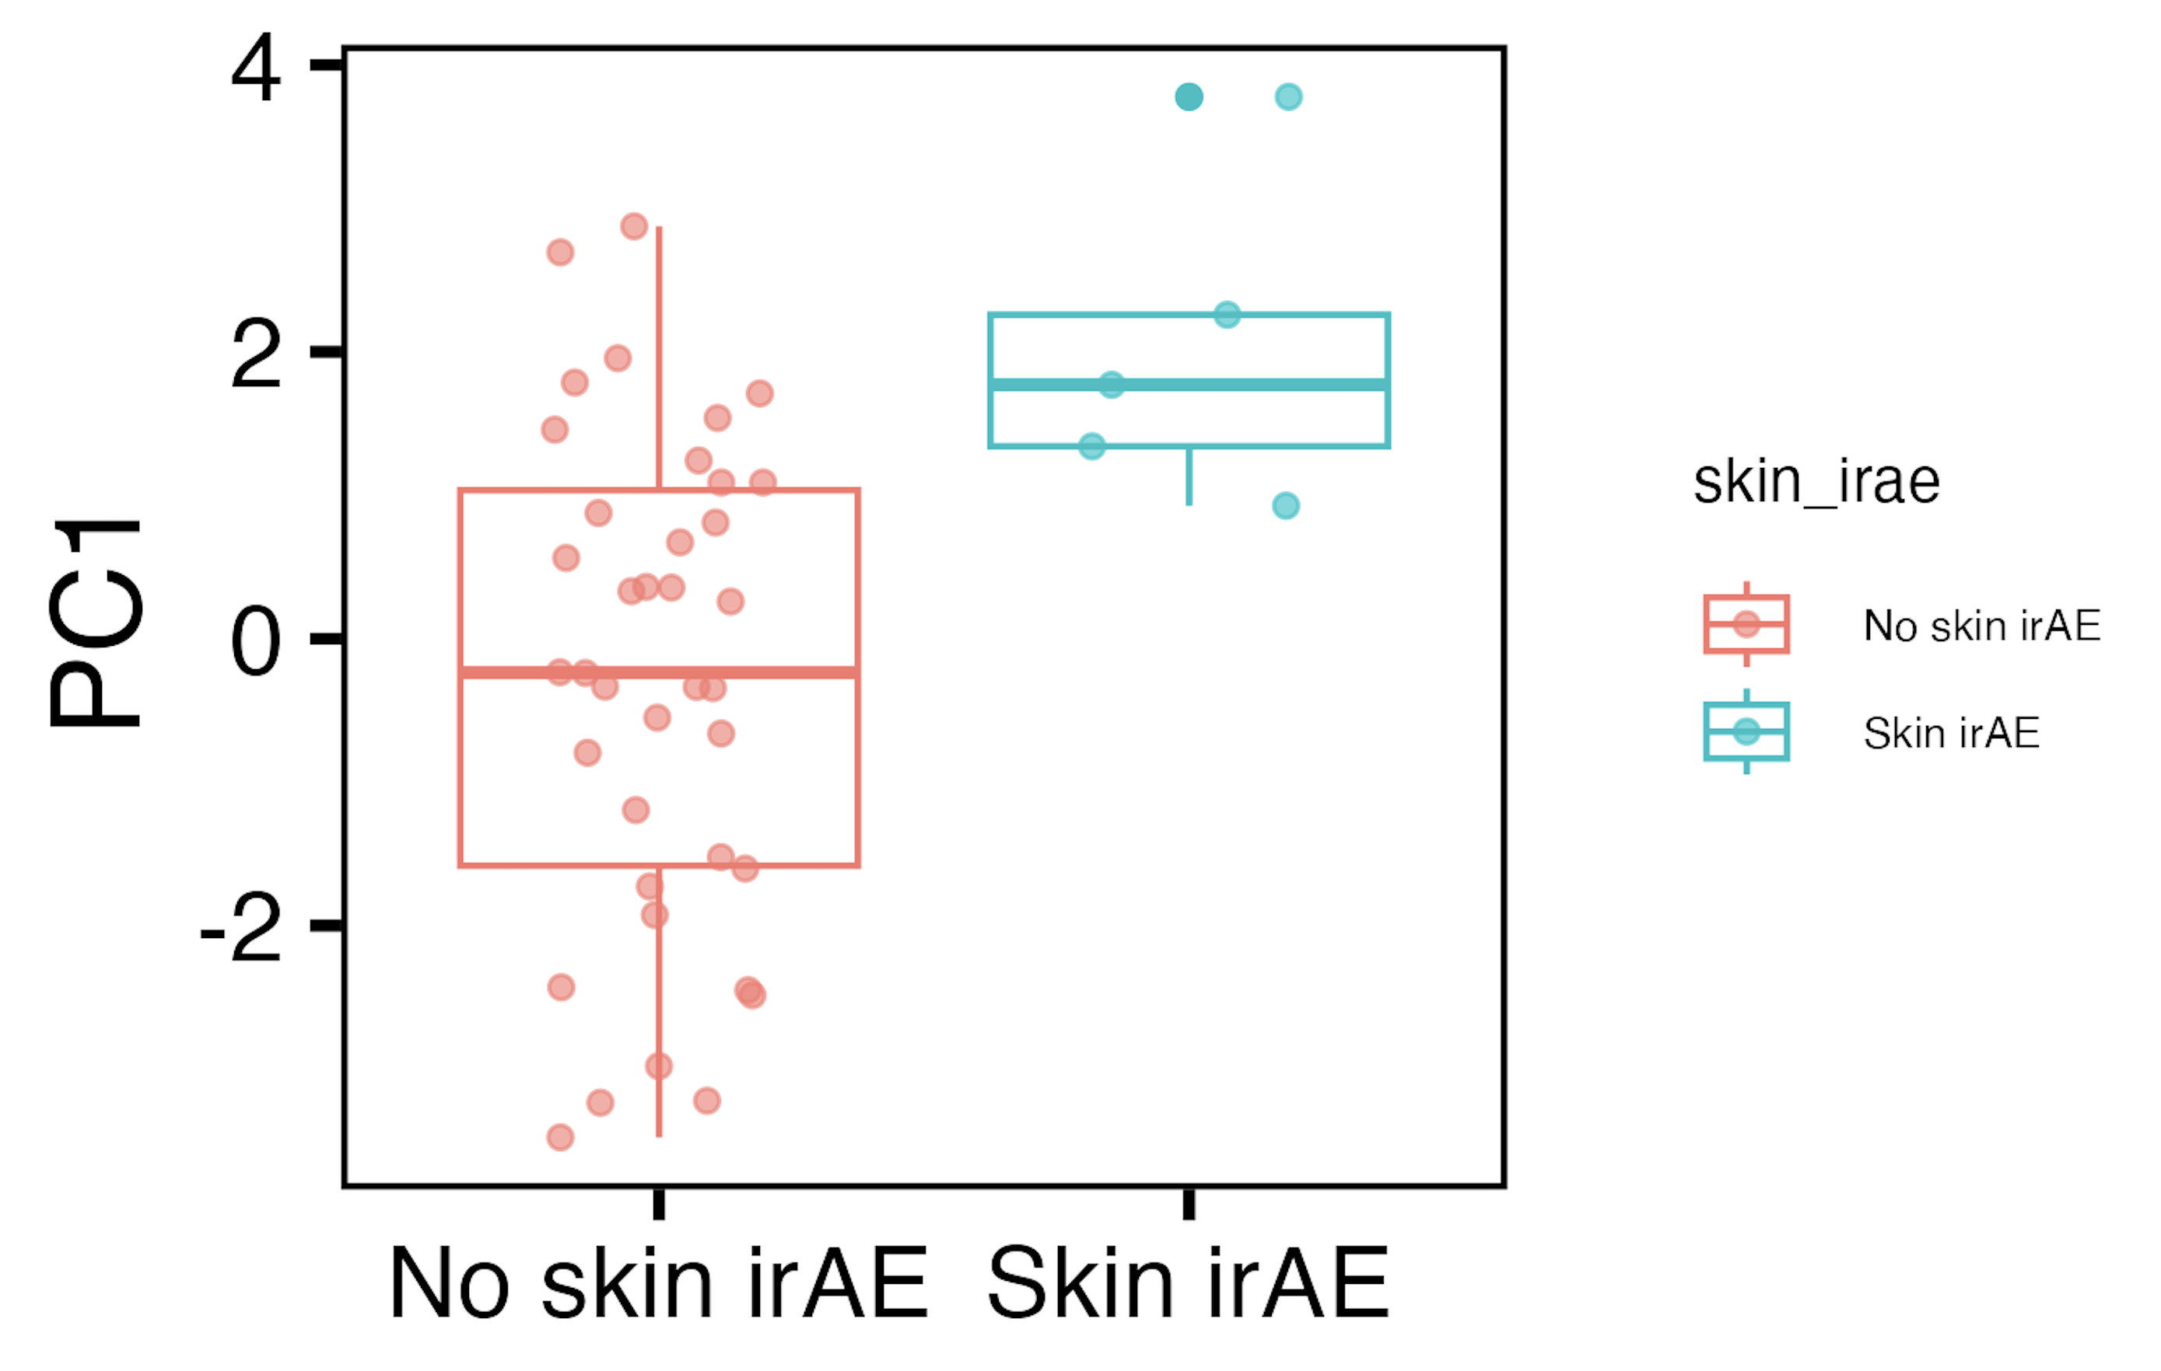
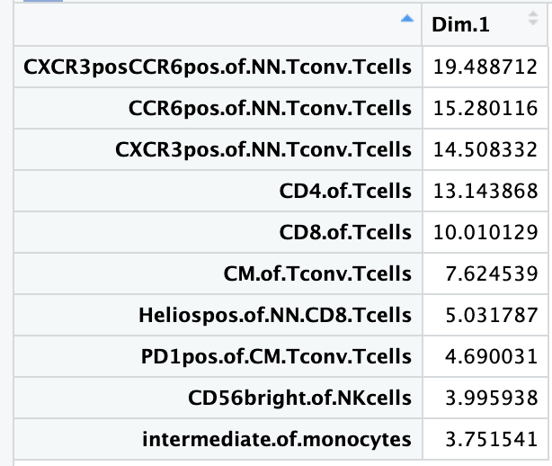
Baseline immunotypes do differ between skin irAE groups in PC1 of PCA using top features
PC1: p = 0.005
Notes:
Batch corrected, logit transformed, Z-scored freqs
Top features here chosen from stats of batch-corrected logit transformed z-scored data unadjusted pval < 0.1

Slide 6
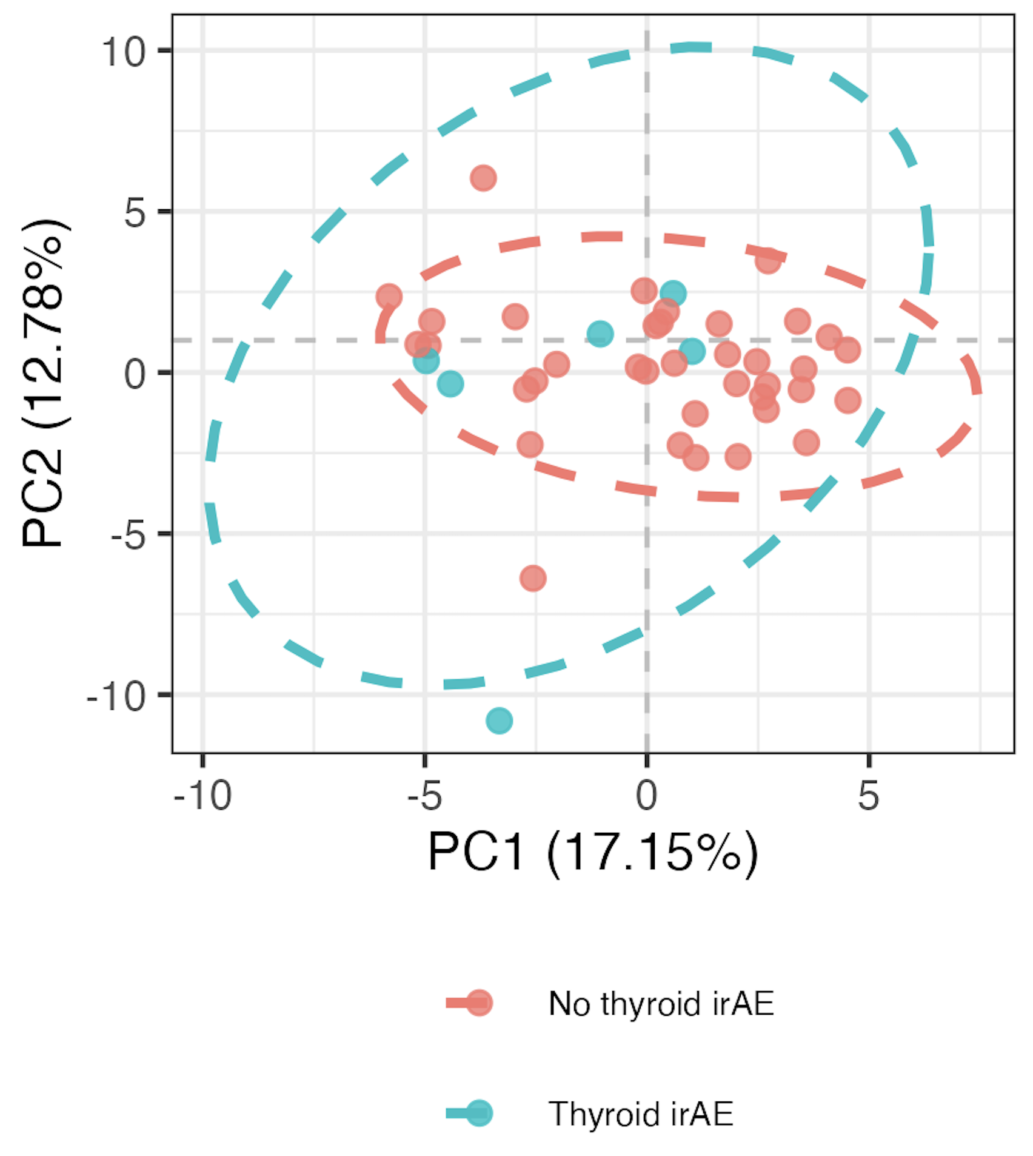
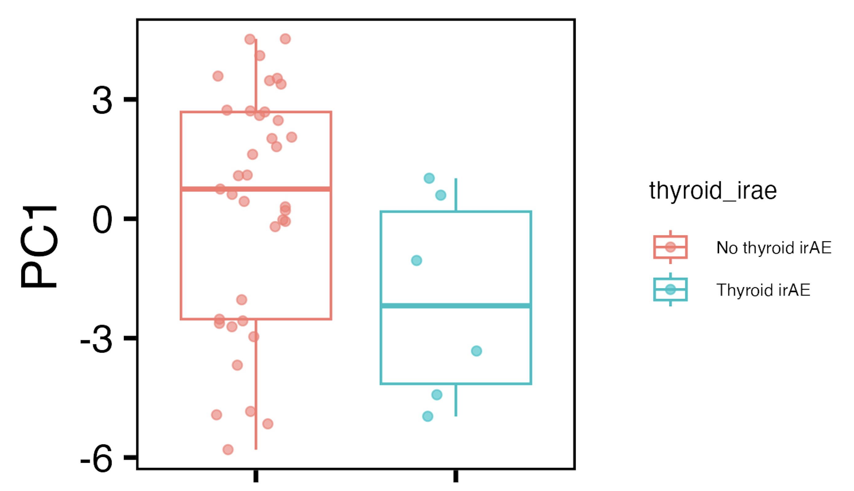
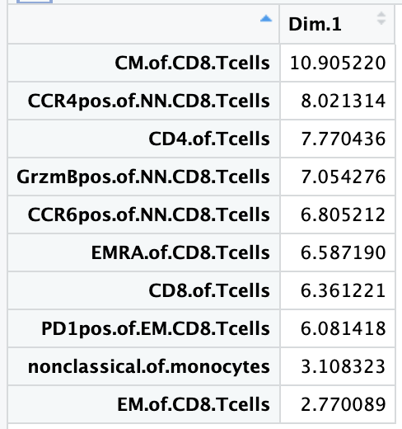
Baseline immunotypes slightly differ between thyroid irAE groups in PC1 of PCA using all features
PC1: p = 0.08
If including OOR, see no differences
Notes:
Batch corrected, logit transformed, Z-scored freqs
ALL features here

Slide 7
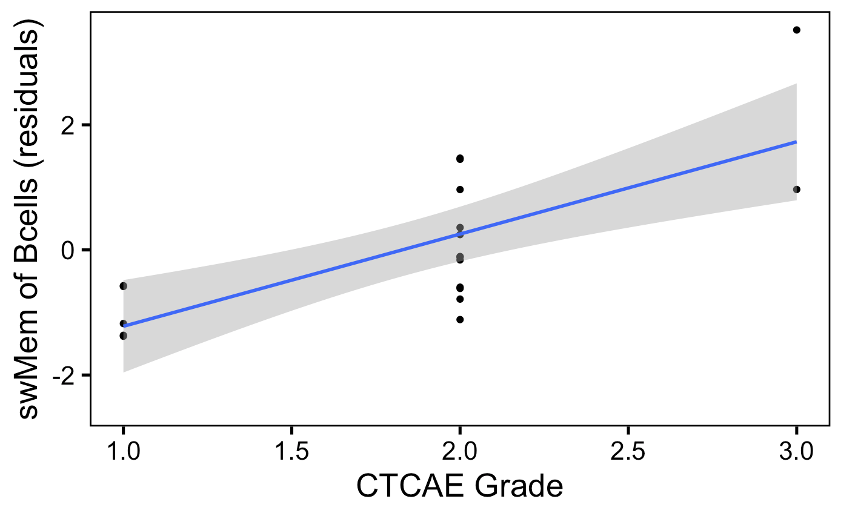
swMem of Bcells weakly correlates with irAE severity
padj = 0.06
Notes:
Batch corrected, logit transformed, Z-scored freqs

Slide 8
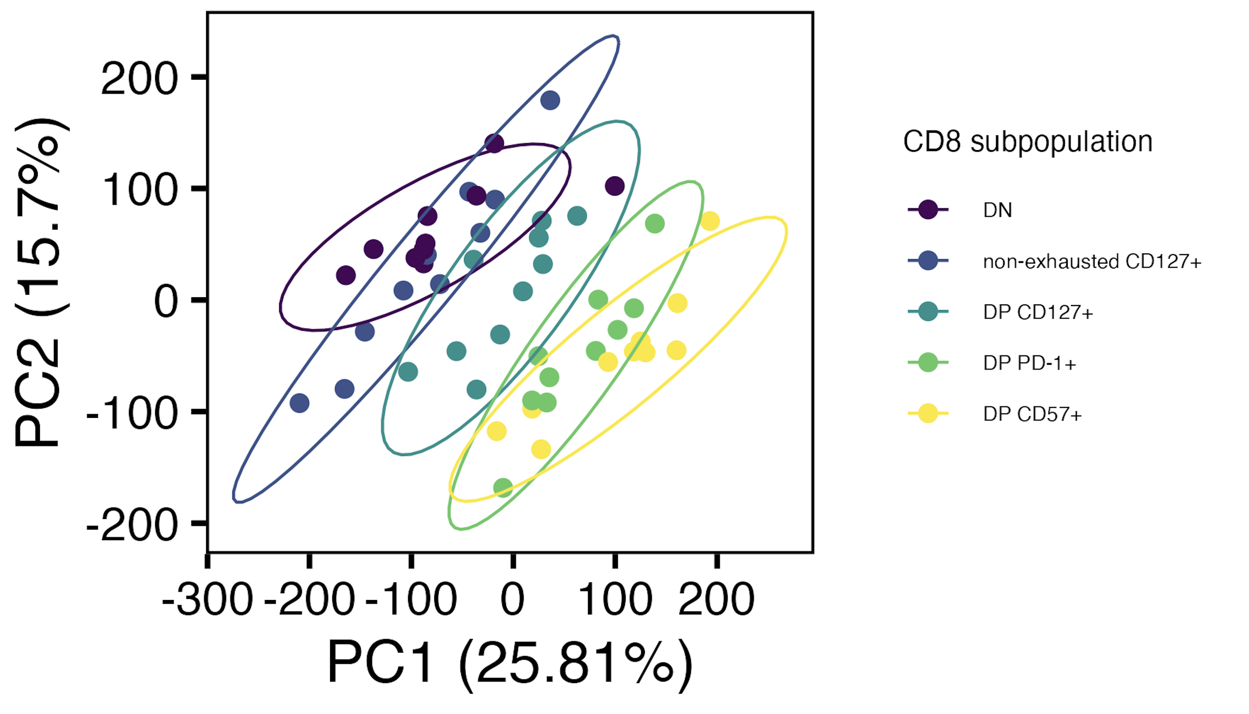
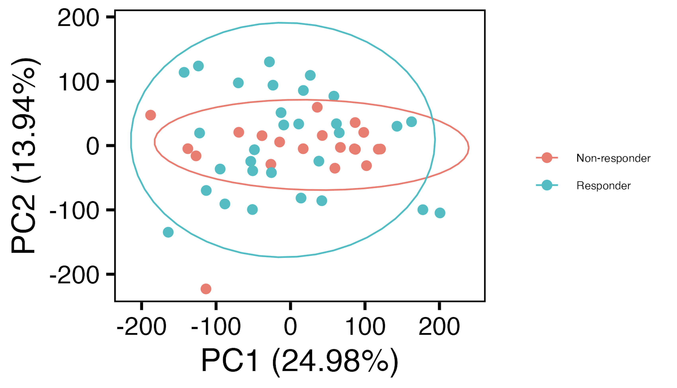
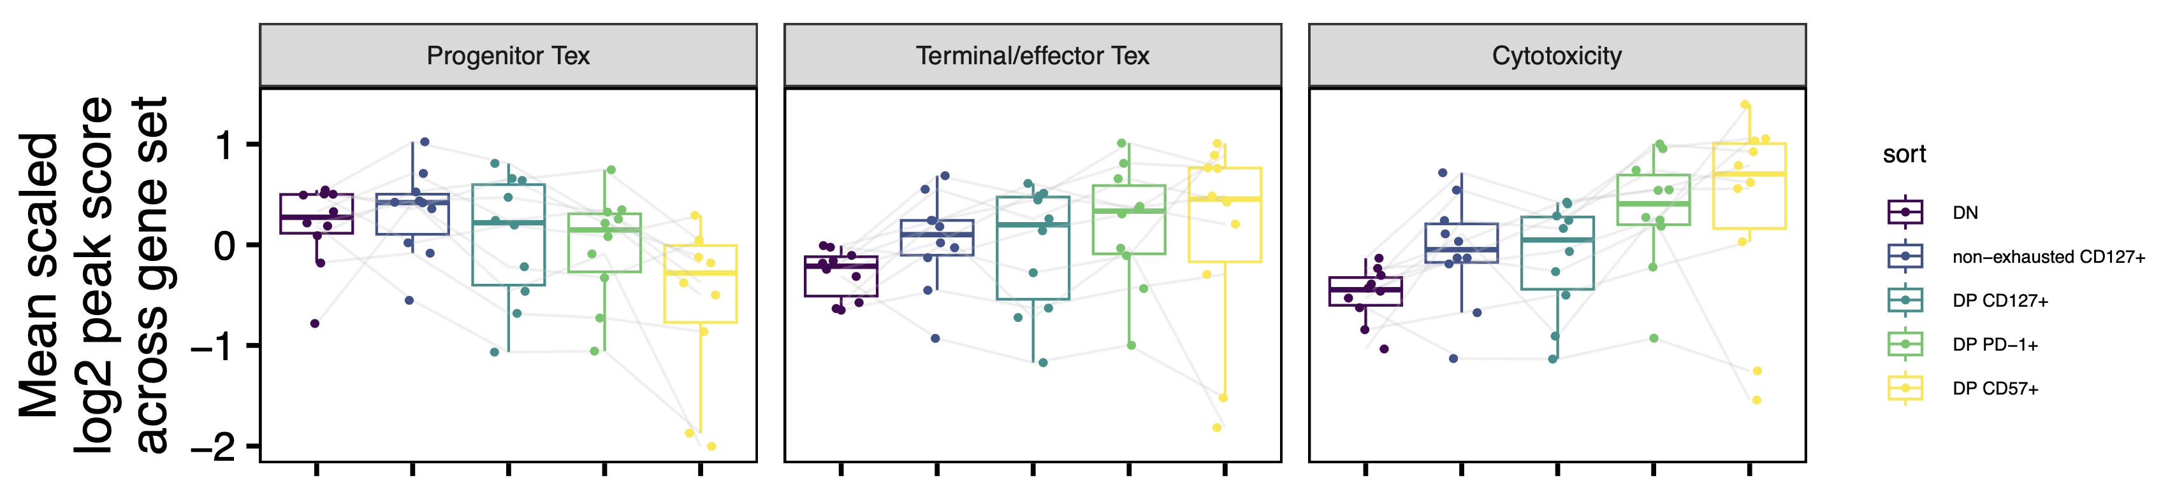
Proposed main fig 1 for AbATE manuscript: epigenetic profiles of non-naïve CD8 subpopulations are distinct
A
B
D: heatmap version of E
C: DPs show signs of exhaustion (vs. DN)
E
E: complementary mean gene coverage plots
Related supplemental figs:
- potential weak effect of telomerase genes more accessible in non-exhausted vs. DP CD127⁺
- potential weak effect of JAK/STAT genes more accessible in CD127⁺ vs. DN
- potential weak effect of purine metabolism genes more accessible in DP CD127⁺ vs. DP CD127⁻
- complementary evidence for prog/term Tex split in HC + T1D scRNAseq/scTCRseq dataset
- Homer results (not strongly consistent/inconsistent with prog/term Tex split)

Slide 9
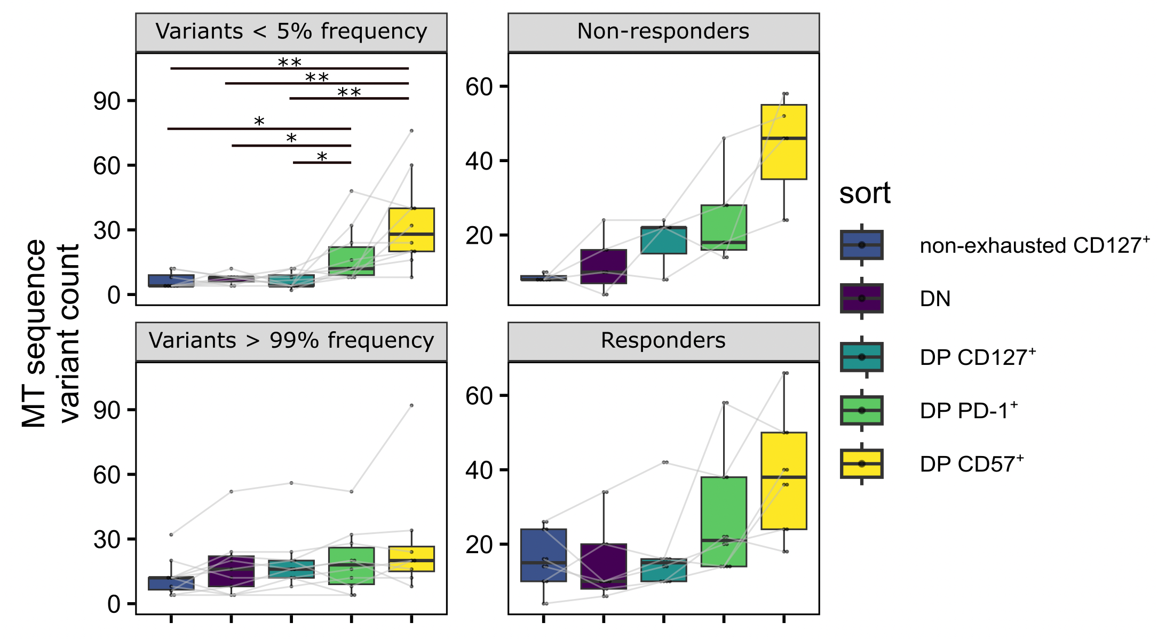
Proposed main fig 2 for AbATE manuscript: MT SNVs inform directionality in differentiation pathway
A: MT SNVs (total) boxplot
B: MT SNVs (total) boxplot R vs. NR
C: MT SNVs low vs. high freq
D: MT SNV sharing upset plot
Related supplemental fig:
- % reads mapping to MT genome
- MT SNV QC: publicity, position of SNVs in MT genome
- bimodal distribution of MT SNV freqs

Slide 10
What else would be nice for AbATE manuscript…

Slide 11
Conclusions
NCI irAE
do observe some immunotype differences at baseline between (skin/thyroid) irAE groups using combinations of features (means, PCs)
swMem of Bcells weakly correlates with irAE severity
AbATE
CD127 levels slightly different between 2 progenitor clusters (TCM vs. TEM) in Erin’s data (data not shown), but not helpful in determining if DP CD8s arise from CD127⁻ and/or CD127⁺ precursors…

Slide 12
Next steps
markers in NCI panel (like CD57) that weren’t gated for can still be analyzed (i.e. apply CD57⁺ IMPACD gate within DP subset)
AbATE manuscript
format as letter?
Nat immun letter
JCI letter

Slide 13
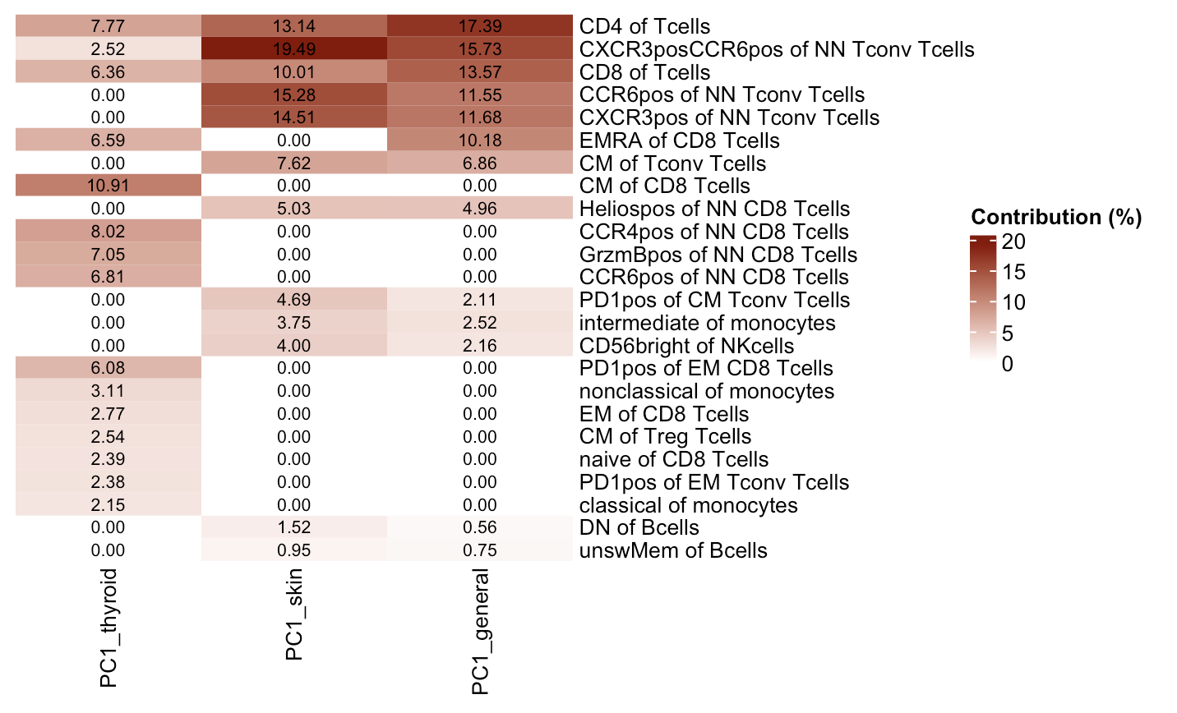
Features contributing to PC1s in 3 baseline irAE comparisons
Notes:
Thyroid comparison coming from all features, other 2 from top features do basically overlap (general just has a 13th feature that skin doesn’t)

